Slide 1
CLIMATE CHANGE
By: 5.a, 5.b & 5.c

Slide 2
Is the climate of the whole Earth really changing?
Yes! Earth has been getting warmer—and fast.
Global climate is the average climate over the entire planet. And the reason scientists and folks like you are concerned is that Earth's global climate is changing. The planet is warming up fast—faster than at any time scientists know about from their studies of Earth's entire history.

Slide 3
What is climate?
"Climate" describes conditions over the long term and over an entire region.
Climate is the big picture. It is the big picture of temperatures, rainfall, wind and other conditions over a larger region and a longer time than weather. For example, the weather was rainy in Los Angeles, last week. But this city usually gets only about 177 mm of rain each year. So the climate for California is dry. Much of Southern California also has a dry, desert climate. Brazil has a tropical climate, because it's warm and rains there a lot. Croatia has a temperate climate.

Slide 4
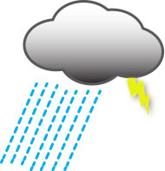
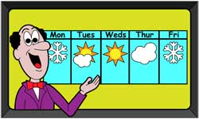
What is weather?
Weather is local and temporary.
On our own Earth, we cannot control weather by turning a thermostat up to make it warmer or down to make it cooler. The best we can do is try to predict the weather. Weather scientists, called meteorologists, try to foresee what's going to happen next.
Is that big black cloud going to let loose over Vinkovci, or wait until it gets to Vukovar? Will that new storm forming in the Atlantic Ocean turn into a hurricane? Conditions are just right for tornadoes. Will any form? And where might they touch the ground and cause trouble?
Weather happens at a particular time and place. Rain, snow, wind, hurricanes, tornadoes—these are all weather events.

Slide 5
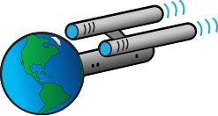
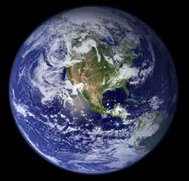
Do we care if Earth is getting warmer?
Yes, we care! After all, Earth is our spaceship.
It carries us on a 932-million-kilometer cruise around the Sun every year. It even has its own "force field." Earth has a magnetic field that protects us from killer radiation and brutal solar wind. For its life-support system, Earth has all the air, water, and food we need.
Just like astronauts on a long space voyage, we need to monitor all our "ship's" vital functions and keep our Earth "ship shape."

Slide 6
Does what we do matter?
Everything that happens here affects something over there.
Earth has its own control system. The oceans, the land, the air, the plants and animals, and the energy from the Sun all affect each other to make everything work in harmony. Nothing changes in one place without changing something in another place. The overall effect gives us our global climate.

Slide 7
What is making Earth's climate warmer?
Scientists have discovered that humans are causing this warming.
But how do they know that? What are we doing that could cause the whole planet to get warmer? And how could warming happen so fast? What will happen to people and other living things if the planet keeps getting warmer? And what can we do to slow down or stop the warming? We need to find answers to these questions together.
We have to work together to save our planet!

Slide 8
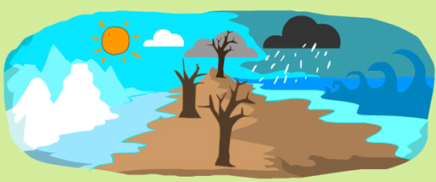
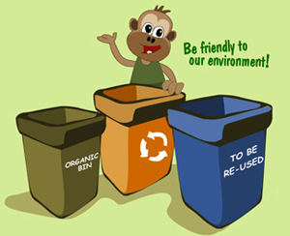
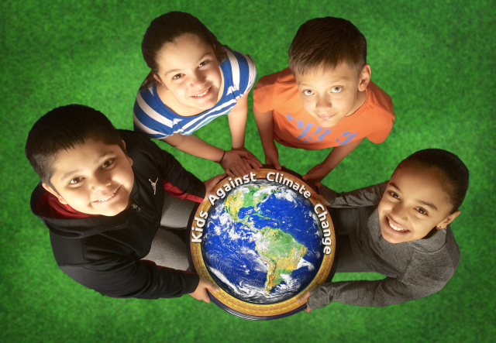
THANK YOU FOR READING AND REMEMBER TO TAKE CARE OF OUR ENVIRONMENT!

